Slide 1
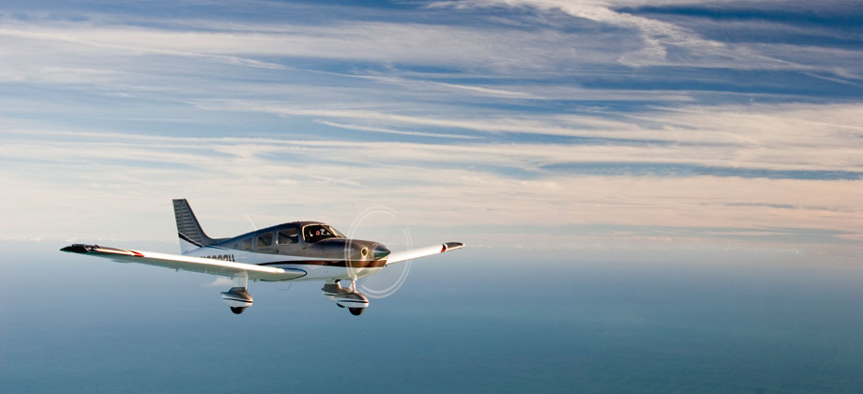
Climbing

Slide 2
Housekeeping
60 minutes
Emergency exit, toilet, kitchen

Slide 3
Aim
To outline the techniques and procedures used in the PA-28 in:
Best rate of climb – Vy
Best angle of climb – Vx
Cruise climb

Slide 4
Motivation
Learn how to handle the aircraft in a coordinated and safe manner during a climb.
With a high competency in the climbing configurations, greatly improve the comfort and safety of passengers as well as improving the efficiency of the aircraft.

Slide 5
Overview
Objectives
Revision
Definitions
Forces acting in a climb
Types of climb
Factors affecting the climb
Application
Airmanship & TEM
Summary
Objectives – revisited

Slide 6
Objectives
At the end of the briefing, you will be able to, from memory and without mistake:
Explain the balance of the four forces in a steady climb
Explain how various factors affect climb performance, specifically what wind does to angle and rate of climb
List the climb power settings and attitudes for the PA28
Describe how to enter, maintain and exit form a climb

Slide 7
Revision
The four forces
Two types of drag
Bernoulli's theory & Lift formula

Slide 8
Definitions
Rate of climb
The rate, in feet per minutes, at which an aircraft climbs – a measure of vertical speed over time.
Angle of climb
The angle of the flight path to the horizontal.

Slide 9
Definitions
Thrust
Is the forward-acting force produced by the propeller. Thrust always acts in the same direction of the propeller shaft.

Slide 10

Definitions
Power
The rate of doing work or work done per unit time. That is
Power = Thrust $×$ Speed

Slide 11
Definitions
Ground speed
Speed of the aircraft over the ground i.e. airspeed plus or minus wind component.

Slide 12
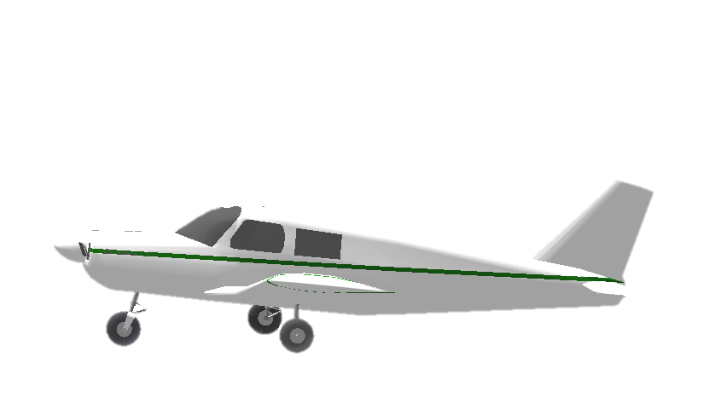
Lift
RAF
Thrust
Drag
Weight
Notes:
Once we pitch up, RAF direction has changed. which force going to change direction.

Slide 13
RAF
Lift
Excess Thrust
Drag
Thrust
Rearward Component of Weight
Weight
Notes:
First im going draw a line under the weight to make same length to the lift. Now you can see lift is less than weight.
And also we have another force which is call rearward component of weight, because is same direction of drag we just moving to behind the drag.
We just add rearward component of weight and drag together that is giving us resultant force. Need to be equilibrium we also need to have other resultant force which is that way.
Thrust is provide the climb

Slide 14
Forces acting in a climb
Lift < Weight
Thrust > Drag
Thrust = Drag + Rearward Component Weight
Notes:
For an aircraft to maintain a steady climb with a constant airspeed, the thrust must exceed the drag
In a climb, the thrust balances the drag and supports a rearward component of the weight. The thrust in excess of that needed to balance it is called excess thrust.

Slide 15
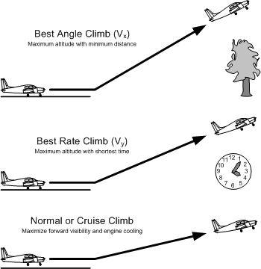
Types of climb – Best Angle
Best angle of climb is concerned with achieving maximum height for minimum distance travelled along the ground.
Best obstacle clearance
Poor cooling
Poor fwd visibility
Notes:
Best obstacle clearance
Disadvantages
Forward visibility
Engine cooling
Important to monitor t and p

Slide 16
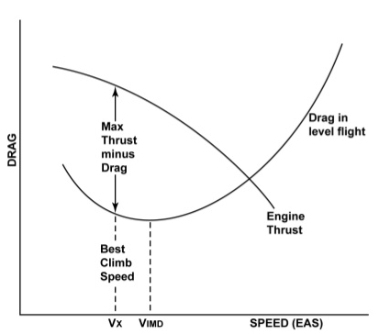
Types of climb – Best Angle
The angle of climb is a product of the amount of excess thrust available.
Best angle of climb occurs at maximum excess thrust.

Slide 17
Types of climb – Best Rate
Best rate of climb is concerned with achieving maximum height in the minimum time.
Have more altitude to manoeuvre if an emergency occurs
Notes:
Maximum height in time
After take off height is safety
Gain height as soon as possible

Slide 18
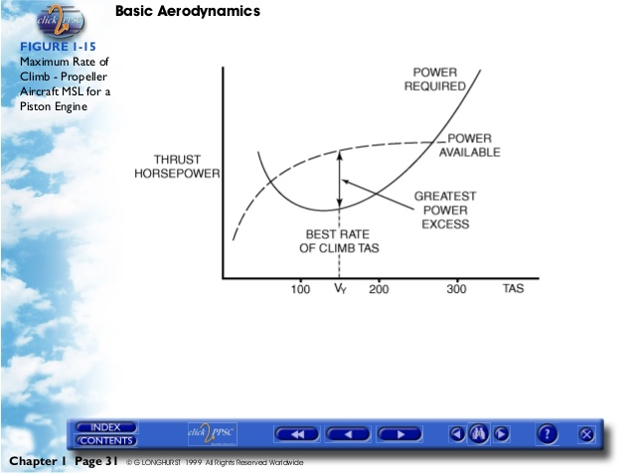
Types of climb – Best Rate
Rate of climb is a product of the excess power available.
Best rate of climb occurs at maximum excess power.
Notes:
RoC is a functoin of excess power, limited by excess power
Power is rate , therefore limits the rate of climb we can achieve

Slide 19
Types of climb – Cruise Climb
Cruise climb is the fastest of all climb speeds and provides better engine cooling.
Lower nose attitude at the shallow climb angle improves visibility.

Slide 20
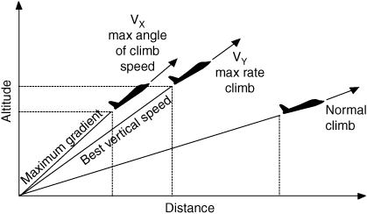
Types of climb

Slide 21
Factors affecting the climb
There are several factors which affect climb performance. Some of these include:
Airspeed
Power
Altitude
Weight
Flaps
Wind

Slide 22
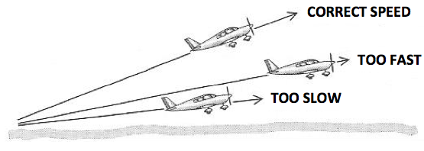
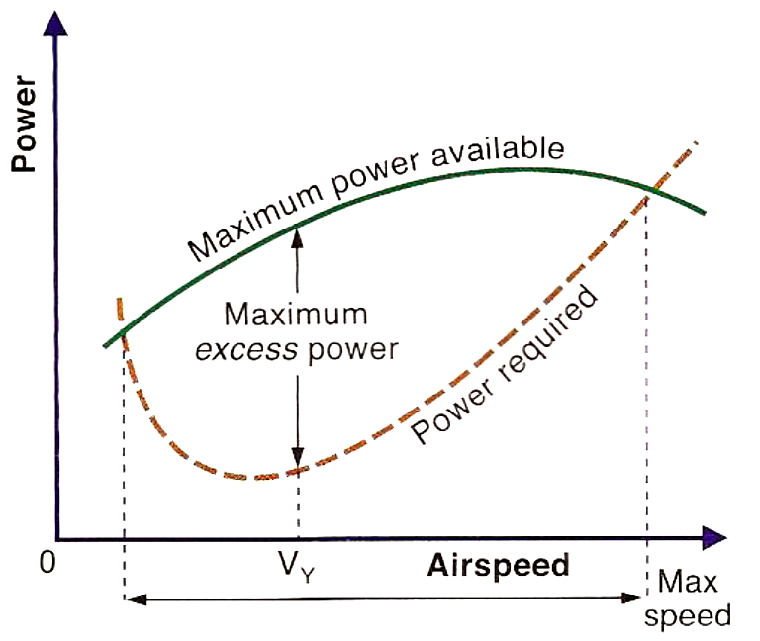
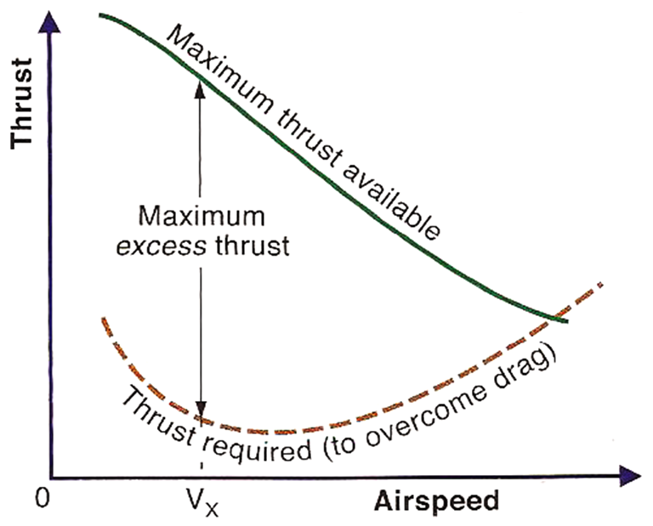
Factors affecting the climb – Airspeed
Any variation of airspeed to the Best Rate of Climb or Best Angle of Climb will result in reduction of climb performance.

Slide 23
Factors affecting the climb – Power
Any setting less than the specified power will decrease both the rate and angle of climb.

Slide 24
Factors affecting the climb – Altitude
Power/Thrust available reduce by Altitude due to less dense air
The reduction in excess thrust/power available reduces both the angle and rate of climb.
Thrust
THRUST REQUIRED
POWER
THRUST AVAILABLE
IAS
IAS
Notes:
Increase in altitude decrease the density
Results in a reduction in engine performance → less dense air
propeller efficiency → thinner air

Slide 25
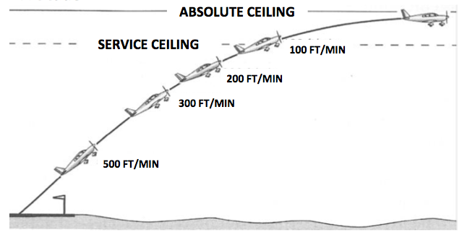
Factors affecting the climb – Altitude
Notes:
Increase in altitude and temp decrease the density
Results in a reduction in engine performance → less dense air
propeller efficiency → thinner air

Slide 26
Factors affecting the climb – Weight
Extra weight needs extra lift, thus creates extra drag. Extra drag reduces excess thrust.
The reduction in excess thrust/power available reduces both the angle and rate of climb.
Thrust
THRUST REQUIRED
POWER
THRUST AVAILABLE
IAS
IAS
Notes:
Higher weight means lift must be increased to maintain the aeroplane in a balanced condition.
Extra lift means extra drag, thus reducing the amount of excess thrust/power available.
Nose must be lowered to maintain airspeed, reduces both Angle and Rate of climb.

Slide 27
Factors affecting the climb – Flaps
Extending the flaps increase drag
The reduction in excess thrust/power available reduces climb performance.
Thrust
THRUST REQUIRED
POWER
THRUST AVAILABLE
IAS
IAS

Slide 28
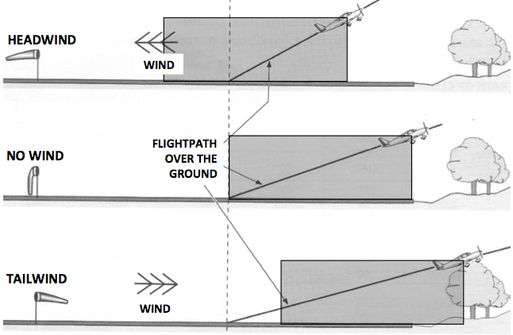
Factors affecting the climb – Wind
Wind does not affect rate of climb, only angle of climb.

Slide 29
Factors affecting the climb – Recap
 | Angle of climb | Rate of climb
Airspeed
Power
Altitude
Weight
Flaps
Wind
Decrease
Decrease
Decrease
Decrease
Decrease
Decrease
Decrease
Decrease
Decrease
Decrease
TW Decrease
HW Increase
No effect

Slide 30
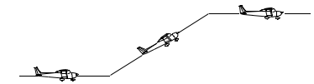
Application
Attitude
Lookout
Attitude
Performance
Lower the nose every 500 ft
Reference point selected
Carburetor heat as desired
Mixture full rich
Temperatures and pressures checked
Lookout – left up, center up, right up
ALAP
AASPT
Anticipate (10% VSI)
Attitude
Speed
Power
Trim
CCHAT
Change
Check
Hold
Adjust
Trim
Pre-Entry Checks
PAST
Power
Attitude
Speed
Trim
Notes:
Anticipate → 10% RoC

Slide 31
Application
Power setting Warrior PA28-161
Past | Vx | Vy | Cruise Climb
Power | Full | Full | Full
Attitude | All sky | Nose on horizon | Just below horizon
Speed | 63 kts | 79 kts | 87 kts
Trim and balance

Slide 32
Airmanship
Lookout
Engine consideration
Notes:
The high nose attitude of the climb creates a bling spot ahead of the aircraft, it is extremely important to lower the nose every 500 ft to clear the airspace for traffic.
Engine is operating at high power and low airspeed during the climb. This inhibits the engine cooling thus it is necessary to check the T and P periodically.

Slide 33
Threat and error management
Threat | Error | Management | UAS
Traffic, high nose attitude | Poor lookout |  | Air proximity event
High power / low IAS |  | Check Temps and Pressures before and during a climb | Engine overheat
Controlled airspace | Unaware of CTA steps | Situational awareness
Lower nose every 500ft
Not monitoring
temperature
Unauthorized flight in CTA

Slide 34
Summary
Types of climb and how to achieve it
Forces acting in a climb
Factors affecting the climb

Slide 35
Objectives – revisited
Explain the balance of the four forces in a steady climb
Explain how various factors affect climb performance, specifically what wind does to angle and rate of climb
List the climb power settings and attitudes for the PA28
Describe how to enter, maintain and exit form a climb.

Slide 36
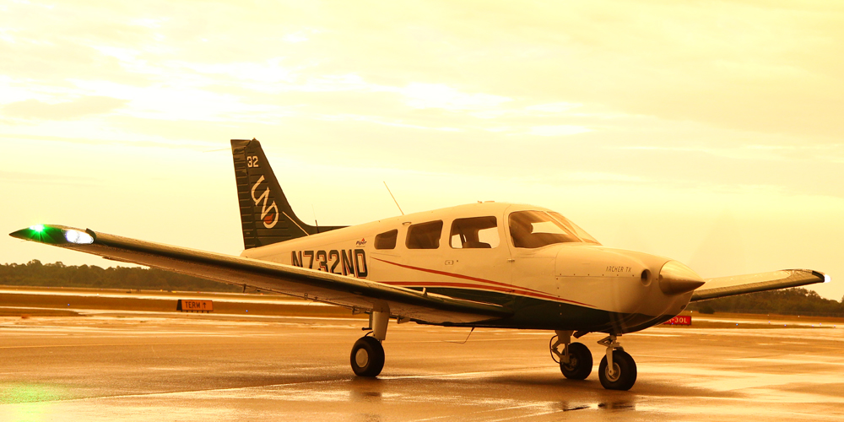
The End

